Slide 1

SQL vs NoSQL:
Civil War

Slide 2
1.How many of you have experience with RDBMS?
2.How many of you have experience with NoSQL?

Slide 3
SQL Intro: What is SQL?
SQL stands for Structured Query Language
SQL lets you access and manipulate databases
SQL is an ANSI (American National Standards Institute) standard

Slide 4
RDBMS
RDBMS stands for Relational Database Management System.
RDBMS is the basis for SQL, and for all modern database systems such as MS SQL Server, IBM DB2, Oracle, MySQL, and Microsoft Access.
The data in RDBMS is stored in database objects called tables.
A table is a collection of related data entries and it consists of columns and rows.

Slide 5
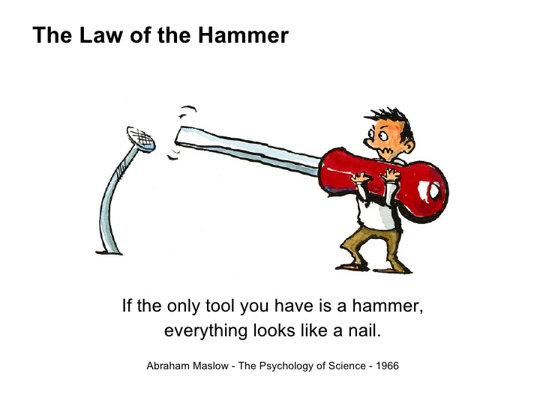

Slide 6
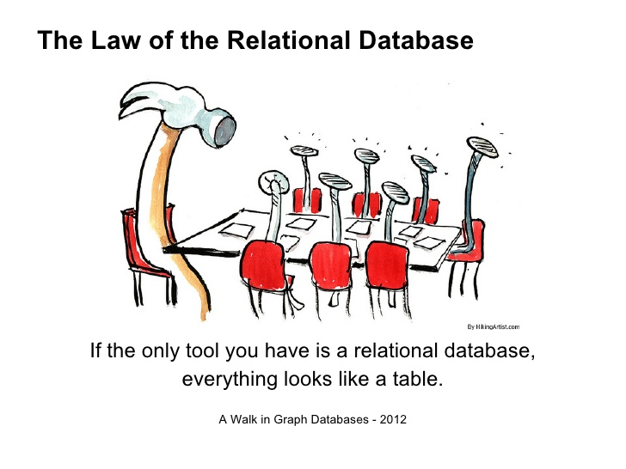

Slide 8
NoSQL Intro
Class of database management systems (DBMS)
Does not use SQL as querying languag
No fixed schema (formally described structure)
No joins (typical in databases operated with SQL)

Slide 9
Type | Examples of this type
Key-Value Cache | Coherence, eXtreme Scale, GigaSpaces, GemFire, Hazelcast, Infinispan, JBoss Cache, Memcached
Key-Value Store
Key-Value Store (Eventually-Consistent) | DovetailDB, Oracle NoSQL Database, Dynamo, Riak, Dynomite, MotionDb, Voldemort, SubRecord
Key-Value Store (Ordered) | Actord, FoundationDB, Lightcloud, LMDB, Luxio, MemcacheDB, NMDB, Scalaris, TokyoTyrant
Data-Structures Server | Redis
Tuple Store | Apache River, Coord, GigaSpaces
Object Database | DB4O, Objectivity/DB, Perst, Shoal, ZopeDB
Document Store | Clusterpoint, Couchbase, CouchDB, DocumentDB, Lotus Notes, MarkLogic, MongoDB, Qizx
Wide Column Store | BigTable, Cassandra, Druid, HBase, Hypertable, KAI, KDI, OpenNeptune, Qbase

Slide 10
SQL vs NoSQL Performance
Perhaps the most controversial comparison, NoSQL is regularly quoted as being faster than SQL.
NoSQL’s simpler denormalized store allows you to retrieve all information about a specific item in a single request. There’s no need for related JOINs or complex SQL queries.
That said, your project design and data requirements will have most impact. A well-designed SQL database will almost certainly perform better than a badly designed NoSQL equivalent and vice versa.

Slide 11
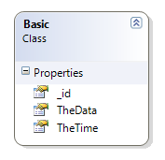
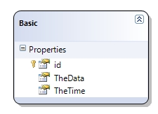
Basic data models

Slide 12
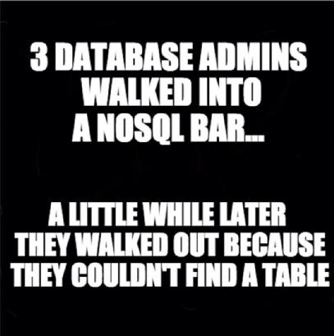

Slide 13
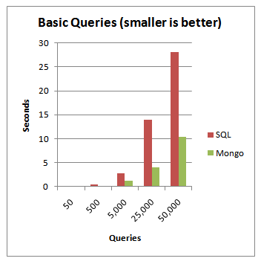
Indexed Id field
Here MongoDB still kicks some SQL butt with almost 3x performance.
If we were to leverage the mad scale-out options that MongoDB affords then we could kick that up to many times more.

Slide 14
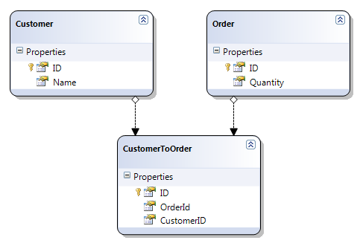
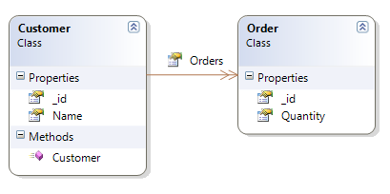
Complex data

Slide 15
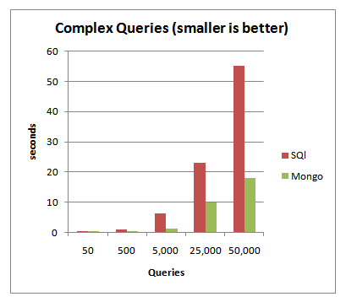
Complex Queries
It shouldn’t surprise you that MongoDB does even better here without its joins.

Slide 16

Say thank you to this computer for test results ;)

Slide 17
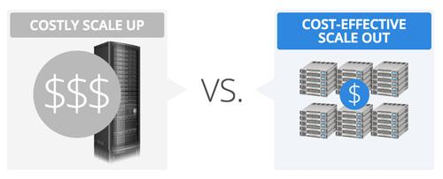
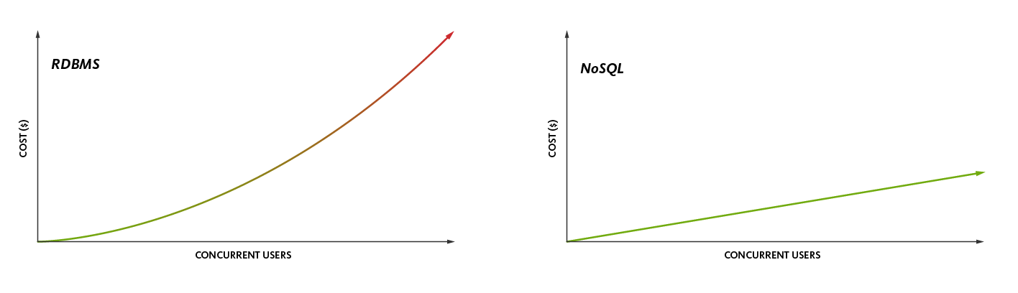
SQL vs NoSQL Scaling
Horizontal scaling
Vertical scaling

Slide 19
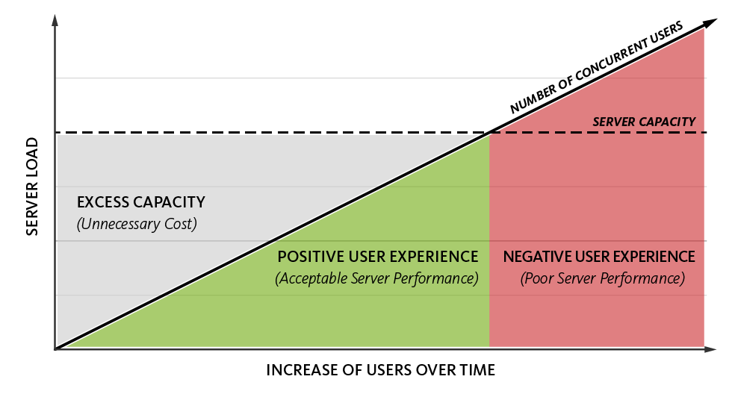

Slide 20
SQL vs NoSQL Transactions
In SQL databases, two or more updates can be executed in a transaction — an all-or-nothing wrapper that guarantees success or failure. If we execute two updates individually, one could succeed and the other fail — thus leaving our figures out of sync. Placing the same updates within a transaction ensures either both succeed or both fail.
In a NoSQL database, modification of a single document is atomic.In other words, if you’re updating three values within a document, either all three are updated successfully or it remains unchanged.
There’s no transaction equivalent for updates to multiple documents.
There are transaction-like options, but, at the time of writing, these must be manually processed in your code.

Slide 21
SQL Normalization vs NoSQL Denormalization
Publisher
id | name | country | email
SP001 | SitePoint | Australia | feedback@sitepoint.com
Book
ISBN | title | author | format | price | publisher_id
9780992461225 | JavaScript: Novice to Ninja | Darren Jones | ebook | 29.00 | SP001
9780994182654 | Jump Start Git | Shaumik Daityari | ebook | 29.00 | SP001

Slide 22
SQL Normalization vs NoSQL Denormalization
Book
{
ISBN: 9780992461225,
title: "JavaScript: Novice to Ninja",
author: "Darren Jones",
format: "ebook",
price: 29.00,
publisher_id: "SP001"
}
{
ISBN: 9780992461225,
title: "JavaScript: Novice to Ninja",
author: "Darren Jones",
format: "ebook",
price: 29.00,
publisher: {
name: "SitePoint",
country: "Australia",
email: "feedback@sitepoint.com"
}
}
Publisher
{
id: "SP001"
name: "SitePoint",
country: "Australia",
email: "feedback@sitepoint.com"
}

Slide 23
Оur experience with databases
Problems with MongoDb
Problems with МySql

Slide 24



+
=

Slide 25

CAP’s theorem

Slide 26
CAP Theorem
It is impossible for a distributed computer system to simultaneously provide all three of the following guarantees:
Consistency - all nodes see the same data at the same time
Availability - a guarantee that every request receives a response about whether it was successful or failed
Partition tolerance - (means that the cluster continues to function even if there is a "partition" (communications break) between two nodes (both nodes are up, but can't communicate))
A distributed system can satisfy any two of these guarantees at the same time, but not all three.

Slide 27
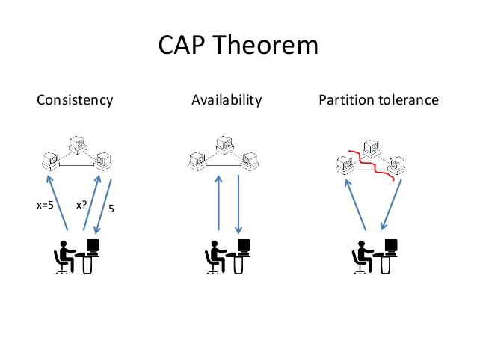

Slide 28
CAP Theorem
In other words, CAP can be expressed as "If the network is broken, your database won’t work"
"won't work" = down OR inconsistent
In RDBMS we do not have P (network partitions)
Consistency and Availability are achieved
In NoSQL we want to have P
Need to select either C or A
Drop A -> Accept waiting until data is consistent
Drop C -> Accept getting inconsistent data sometimes

Slide 29
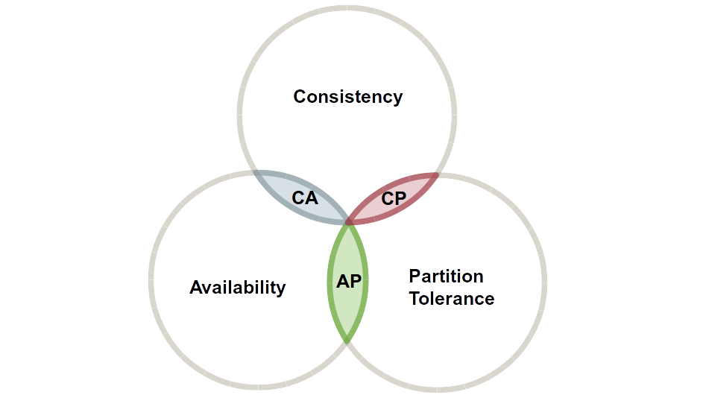

Slide 30
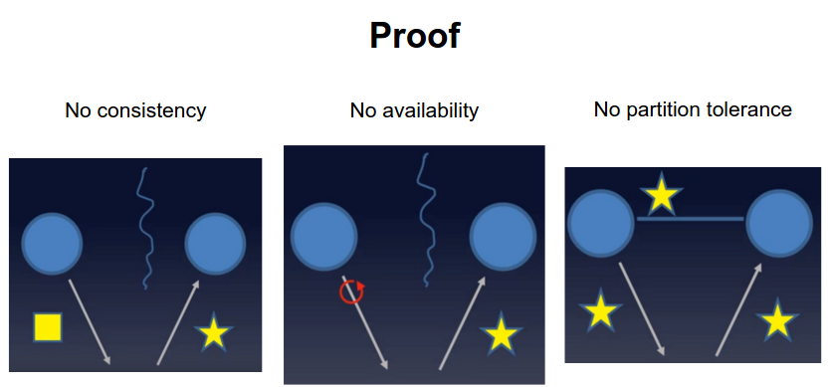

Slide 31
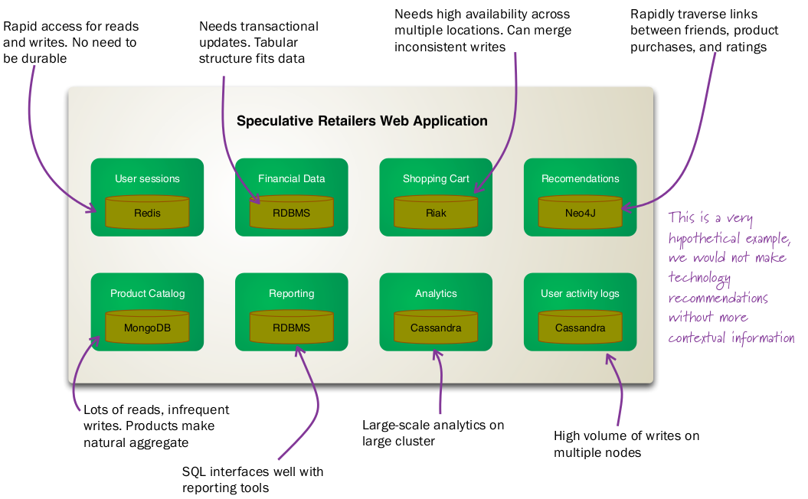
Polyglot Persistence

Slide 32

Java vs JavaScript
But that's another story :)

